Slide 1
BIP Progress Monitoring
City School District of Albany
Presented by: Cathy Huttner and Brianna Olsen

Slide 2
What we will learn today:
What to progress monitor
How to progress monitor
When to progress monitor
What to do with the data
Whaaat?

Slide 3
What to progress monitor?
Target Behavior
(first and foremost!)
Replacement Behavior
Integrity of BIP

Slide 4
What you shouldn’t do…

Slide 5
What to progress monitor?
Target Behavior
The behavior you are measuring is the SAME behavior selected for the FBA… which is the SAME behavior addressed in the BIP.
Use the SAME measurement (frequency, duration, latency, time sampling)
Compare “apples to apples”

Slide 6
What to progress monitor?
Replacement Behavior
Determine if the child is using the skills being taught to him/her – is this working?
Helps to determine if the teaching strategies are effective – is this working?
We want to see an increase in the replacement behavior /decrease in the target behavior – is this working?

Slide 7
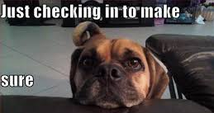
What to progress monitor?
Integrity of BIP
Data is useless if the BIP is not being implemented with integrity
Before making any decisions about modifying a BIP, we must determine that the BIP was implemented as written.
Checklists, team meetings, observations

Slide 8
What to progress monitor?
Integrity of BIP
What do we do if it wasn’t implemented with integrity?
Determine if the plan is feasible. Is it practical given the amount of support in the classroom, across settings, etc.?
If not, change plan.
Remember, a BIP is considered a legal document and we must implement it as written

Slide 9
How to progress monitor
Target Behavior
Use the SAME measurement used for the FBA
Replacement Behavior
Use the SAME measurement used for the target behavior

Slide 10
How to progress monitor
Integrity of BIP
Suggestion: Create a checklist of the strategies (interventions) in the BIP
Antecedent
Teaching
Consequence
Keep it simple
Yes or No… is the intervention implemented consistently across settings, staff, etc?
If no, why?

Slide 11
When to progress monitor
Target Behavior
Low frequency/high intensity
behaviors should be
documented when
they occur
High frequency behaviors can
be measured 1-3 times per
week during a specified
observation time
All behaviors that warrant an incident report will be documented
(safety concerns)

Slide 12
When to progress monitor
Target Behavior
Set up a schedule before implementing the plan
Split up responsibilities amongst your TEAM
Keep it simple

Slide 13
When to progress monitor
Replacement Behavior
Again, depends on the frequency that the behavior could potentially occur
Low frequency behaviors can be recorded each time they occur
High frequency behaviors (i.e. staying in seat, raising hand, following directions) can be measured more infrequently
Progress monitoring the target behavior is the priority

Slide 14
When to progress monitor
Integrity of BIP
Weekly
A checklist allows for easy documentation of integrity of implementation
It is critical that plans are implemented as written

Slide 15
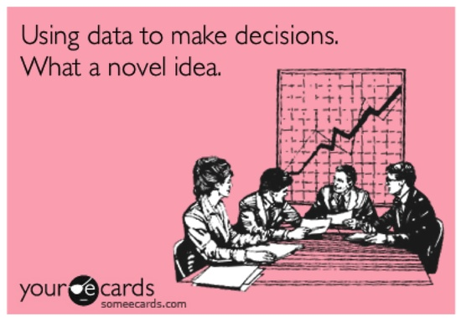
What to do with the data

Slide 16
What to do with the data “The reason most interventions fail is that they are not used… and the reason they are not used is because they are not feasible”
Meet as a team at a minimum every 6-8 school weeks
Ask yourself… Was the plan implemented with integrity?
If not, was it impractical or was it simply not implemented?
If it was impractical, modify the plan.
If it simply was not implemented, implement it with integrity before determining the effectiveness of the plan.

Slide 17
What to do with the data
Do we have to wait 8 school weeks to meet as a team?
No, if the target behavior is significantly worse after 2 weeks, schedule a meeting.
No, if the behavior is resulting in a significant safety concern, schedule a meeting.
Be aware that oftentimes behaviors do get worse before they get better after a BIP is implemented

Slide 18
What to do with the data
Data are used to guide decision-making
Continue interventions
Modify interventions
Begin new interventions
Fade existing interventions

Slide 19
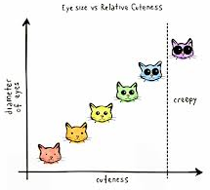
What to do with the data
Graph it using a line graph-
visual representation makes it easy
for the entire team to
understand data
How many data points?
The more data points we have,
the more confidence we have in our data
Rule of thumb: at least 8 data points
(although more is better!)

Slide 20
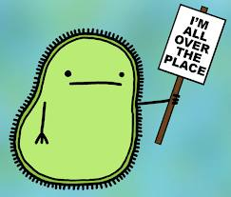
What to do with the data
Variability
data points “all over the place”
Is the plan being implemented as written?
Are setting conditions impacting behavior?
The greater the variability, the greater the number of data points needed to establish a predictable pattern of behavior

Slide 21
What to do with the data
Look at trend - the overall direction taken by the data path of the target behavior
Increasing - target behavior is getting ‘worse’
Decreasing- target behavior is getting ‘better’
No change- target behavior is not changing
(Read as if the Target Behavior describes an inappropriate behavior)

Slide 22
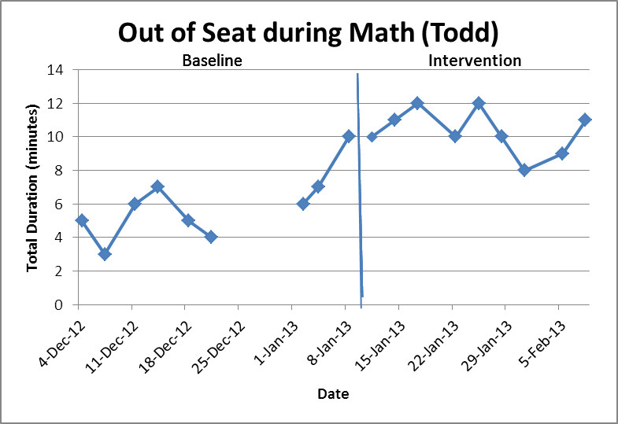

Slide 23
What to do with the data
The target behavior is increasing
Is the plan implemented with integrity?
Is the function correct?
Were correct setting events and antecedents properly identified?
Do we need to modify interventions?
Do we need to develop different interventions?

Slide 25
What to do with the data
The target behavior is decreasing
Is the plan implemented with integrity?
Do we continue the plan?
Do we fade interventions?
Do we stop interventions?

Slide 26
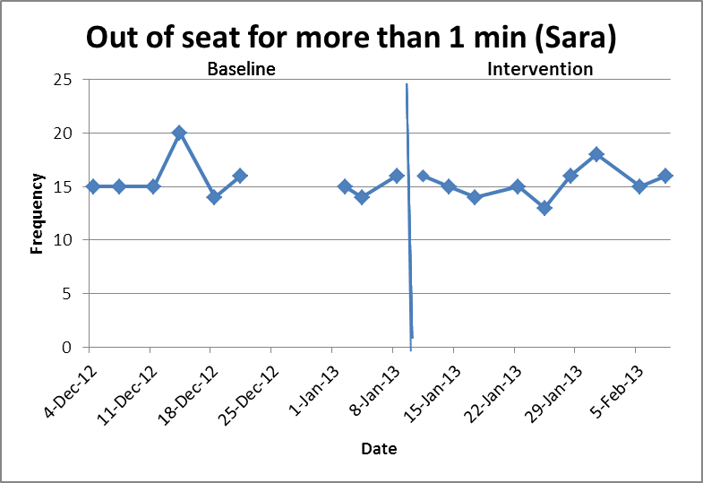

Slide 27
What to do with the data
The target behavior is not changing (or very little change)
Is the plan implemented with integrity?
Is the function correct?
Do we modify interventions?
Do we stop interventions?
Do we develop new interventions?

Slide 28
So… why do I have to measure Replacement Behavior, too?

Slide 32
Questions???

