Slide 1
Positive Behavioral Interventions and Supports & Response to Intervention-Behavior
ALBANY CITY SCHOOL DISTRICT
2016-2017
NEW STAFF ORIENTATION

Slide 2
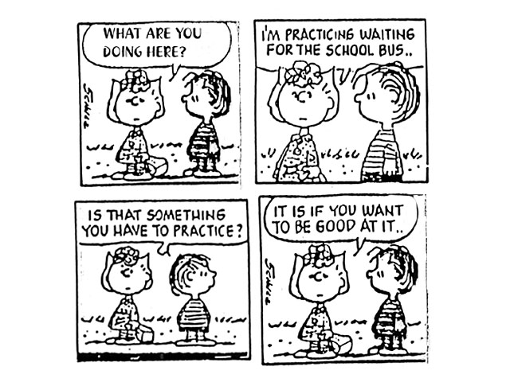
Notes:
This carton is the basis of PBIS. Everything needs to be taught.

Slide 3
1980 PBIS model developed; University of Oregon
1997 Individuals with Disabilities Education Act (IDEA)
2004 Reauthorization of Individuals with Disabilities Education Act (IDEA)
PBIS, referred to as Positive Behavioral Interventions and Supports in IDEA, is the only approach to addressing behavior that is specifically mentioned in the law.
The emphasis on using functional assessment and positive approaches to encourage good behavior remains in the current version of the law as amended in 2004.
Notes:
REGULATORY HISTORY

Slide 4
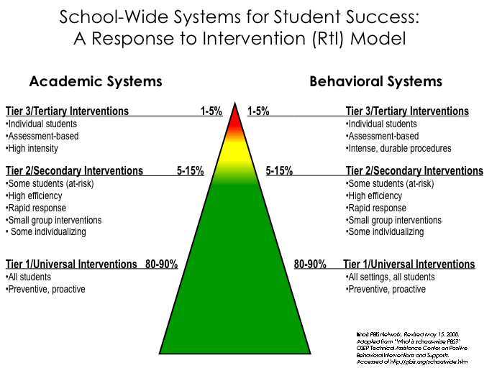
Notes:
4
Review triangle and Tier percentage expectations.
Focus on the similarity between A and B

Slide 5
PBIS
Positive Behavior Interventions/Instruction and Supports
District Wide Initiative
PBIS is a philosophy/belief. It is the belief that all kids can succeed as long as they are given the tools, connections and relationships to do so. Need to spend time on developing this culture and climate.

Slide 6
Research has found that PBIS has done the following for schools…
Establish positive school cultures
Increase academic performance
Increase socially appropriate behaviors
Promote a safer school climate

Slide 7
PBIS Big Ideas
Positive Behavior Support is a process for teaching children appropriate behavior and providing the supports necessary to sustain that behavior.
PBIS is not a curriculum - it is a foundation for systems to identify needs, develop strategies, and evaluate practice toward success

Slide 8
Keys Components of PBIS
Using data to drive decisions
Developing a behavioral matrix
Teach expectations
Reinforce and recognize behaviors
Develop and follow through with consistent redirection and correction procedures

Slide 9
What are the primary elements of PBIS?
PBIS emphasizes FOUR integrated elements:
Data for decision-making
Measurable outcomes supported and evaluated by data
Practices that are achievable and evidence based
Systems that efficiently and effectively support implementation of these practices

Slide 10
Expectations & behavioral skills are taught & recognized in natural context

Slide 11
Expectations
Schools identify 3 to 5 overarching expectations which reflect the needs of the school community. The expectations are stated briefly and in a positive manner.
They often are:
Be Respectful
Be Responsibility
Be Safe

Slide 12
 | BUS | Cafeteria | Hallway | Learning Environment | Bathroom | Assemblies | Playground
BE SAFE | *Click in *Stay seated *Face forward *Hands and feet and objects to self | *keep hands feet and objects to self *stay at table *walk and move carefully *Wait in line patiently | *keep hands, feet and objects to self *walk and move carefully *HALL *walk in double lines and line the wall *follow stair case directions. | * move carefully *keep hands, feet objects to self *push in chair *use material appropriately | *walk and move carefully * keep hands, feet objects to self | * keep hands, feet objects to self *stay seated | *keep hands, feet objects to self *move carefully *play safely
BE RESPECTFUL | *listen to the driver *use encouraging, polite and kind words *speaking voices *respect property | *use encouraging, polite and kind words, *speaking voices | *quiet wave *silence *be respectful of student work/materials | *listen and talk at appropriate times * use encouraging, polite and kind words *be an active participant *use appropriate voice | *honor others privacy *speaking voice | *listen and respond appropriately *applaud when appropriate *use appropriate voice level *enter and exit quietly | * use encouraging, polite and kind words *include others *good sportsmanship *share *take turns *help others
BE RESPONSIBLE | *keep bus clean *keep track of belonging *follow rules | *keep area clean and throw away trash *accept consequences graciously | *keep hallways clean *accept consequences graciously *stay with line *go straight to destination *report incidents to an adult | *complete homework and classwork *work hard and do your best *accept consequences graciously *be prepared and ready for the day *listen and follow directions quickly *keep personal belongings organized | *keep area clean and throw away trash *flush *wash hands * report incidents to an adult *get in and out in timely manner *use for intended purpose | *follow directions * accept consequences graciously | * accept consequences graciously *line up when called

Slide 13
Student Acknowledgement
Acknowledgement of good decision-making and achievements on the part of students and adults goes far in helping one develop positive self-worth and motivation to achieve.
PBIS allows staff to acknowledge positive behavior and achievement on an on-going basis.
In addition to verbal praise, staff and students can be acknowledged in a variety of ways throughout the school year.

Slide 14
Consistent Responses
Responding to negative behavior
Immediate and consistent
Use natural consequences when possible
Use the right tool for the job
Pre-plan and teach
Correction and re-teaching

Slide 15
Acknowledge Socially Appropriate Behaviors
Once socially appropriate behaviors have been introduced and taught, they need to be acknowledged on a regular basis.

Slide 16
Corrective Strategies/ Interventions:
Maintaining Desired/Expected Student Behavior
Redirection
Planned ignoring
Restitution
Re-teaching
Stress break
Proximity & Movement
Modeling
Cueing (verbal & nonverbal)
Notes:
A corrective consequence is...An undesired action or event that follows a behavior and serves to decrease it.
If you decide to use negative consequences, select those within school policy, easy to administer, and compatible with your philosophy. Make sure they are reasonable and enforceable.
Modeling---this is one of the most powerful tools in teaching-we can send negatives or positives
When using “fines”, remember that repetitive written work may lead to dislike of writing that spills over into and is counterproductive to academic work.---this is not the same as requesting a reflection paper or journaling.
Punishment may increase the undesired behavior
Severe and immediate punishment that may be permanently effective is illegal and ethically forbidden
If the punishment you continue to use on the same student for the same infraction in not effective, do something different because, obviously it is not stopping the behavior. Stop doing ineffective things.

Slide 17
Discipline is….
The actions parents and teachers take to increase student success (Charles, 1980).
Prevention
Rules, Routines
Reaction Consequences

Slide 18
What does PBIS & RtI-B look like in Albany?

Slide 19
RtI-B Teams in Buildings
Every school has…
PBIS Team
RtI Tier 2/3 Team

Slide 20
PBIS Team
This team is in charge of Tier 1 at the building level:
Meets
Reviews building data,
Plans school-wide celebrations
Develops Tier 1 building interventions.
Notes:
Colleen

Slide 21
RtI Tier 2/3 Team
This team is tasked with Tier 2 & 3 decision making:
Meets a minimum of bi-weekly; reviews all students who have Tier 2 & 3 intervention
Looks at individual student data (both behavior and academics)
Develops individual interventions
All students who are initially referred should be reviewed by the whole committee.
Once students have been reviewed, sub committees will follow through with the student and teaching team

Slide 22
Tier 1

Slide 23
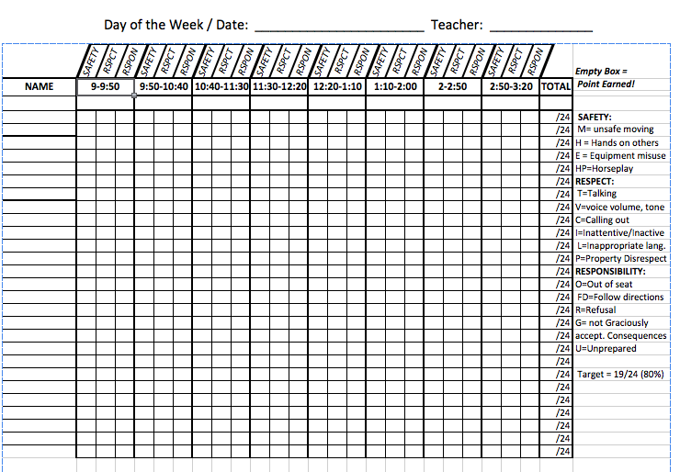

Slide 24
Point Sheet Fidelity
Point sheet fidelity:
Very important.
Points determine if or when a student gets an intervention.
Teachers should code their point sheets to determine interventions based on:
What behaviors are occurring and
How often those behaviors are occurring
Buildings should create a building-wide code
Notes:
Colleen

Slide 25
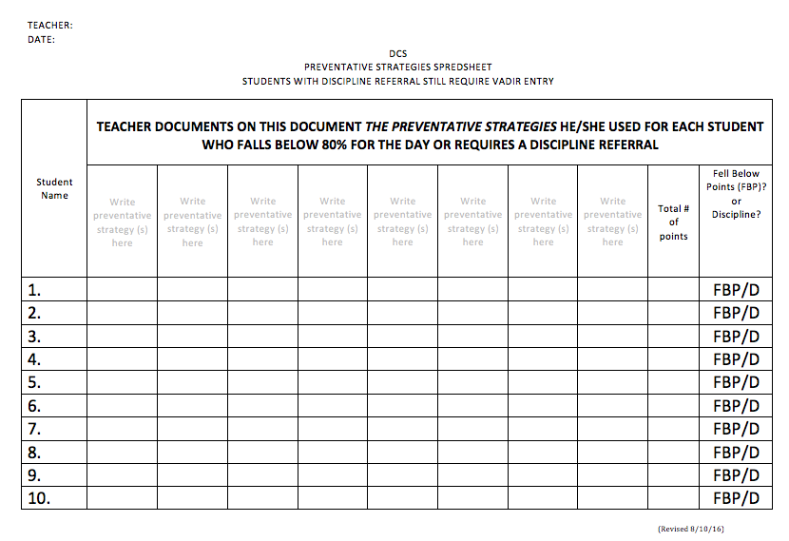
Preventative Strategies

Slide 26
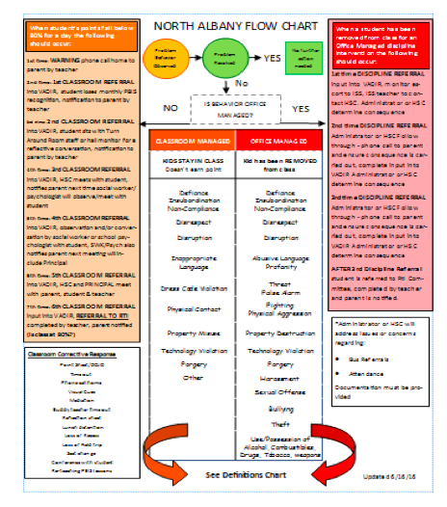

Slide 27
Tier 1 Building Flow Chart Tracking Sheet
The tracking form must be maintained on a daily basis to ensure fidelity of the Building Flow Chart
Principal will assign one staff member to this responsibility
Teacher is STILL responsible to enter VADIRS report for any Discipline Referral
The tracking sheet should be completed at the same time every day for the prior day using Preventative Strategies Spreadsheet &/or VADIR reports
Assigned staff will complete required tasks (e.g., call parent, meet with student, etc.)

Slide 28
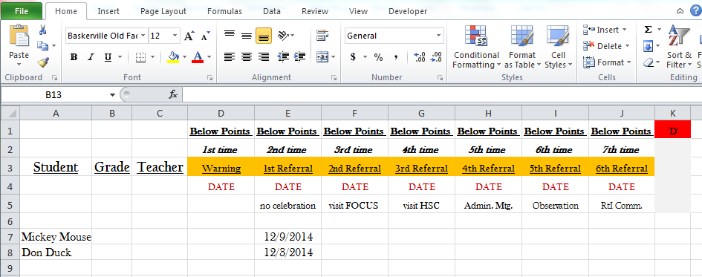
Tier 1 Building Flow Chart Tracking Form

Slide 29
Tier 1 Class wide Behavior Management What every Tier 1 Classroom should look like and sound like
Physical Plant – Class Design
PBIS materials are posted
Reinforcers/Point Sheets
Re-teaching
Engagement
Caring Relationship Building
Positives: Negatives
This is how you build your foundation
Notes:
This is what we will be covering today.

Slide 30
Classroom Behavior Support Plans CBSP’S
All teachers should have a CBSP written prior to the start of the school year
The CBSP guides behavior management
CBSP Key Components:
Posters and how to refer to them
Behavioral expectations
Routines and Procedures
Reward System
Student Engagement
Building Caring Relationships
Positives to negatives
Notes:
Colleen – reference power point on website

Slide 31
Notes:
Colleen

Slide 32
Second Step
K-8 District-wide initiative
Tier 1 classroom-based universal social emotional curriculum
Teacher Implemented at Tier 1
Meets DASA requirement
Notes:
Colleen/ Cathy

Slide 33
Tier 1 Classroom Fidelity Checks
Classrooms need to be at 80% in order for students to be given Tier 2 and 3 interventions.
Notes:
Colleen

Slide 34
Tier 1 Classroom Fidelity Checks
Tier 1 fidelity checks are completed in all classrooms
Once it is established that the CBSP is implemented with fidelity, a Tier 1 targeted plan can be developed for a classroom that is still struggling at Tier 1
Changing what occurs in the classroom will be much more effective for students then pulling them out for interventions.
Tier 1 individual interventions can be done in the classroom as well prior to moving students to Tiers 2 & 3 .
Notes:
Colleen

Slide 35
Tier 2

Slide 36
How does a student become a student receiving Tier 2 supports?
Tier 2 interventions ONLY occur when:
The child works his/her way through the referral process (flow chart) AND
their class is functioning at 80%
Once they have worked their way through the process, a referral to the full RtI Committee should be made.
Notes:
Colleen

Slide 37
Prior to and during RtI Meeting
BOTH academic and behavior data should be brought to the RtI meeting regardless of the purpose of the referral
Behavior data must be:
Graphed AND
Analyzed prior to meeting to determine patterns of behavior such as time of day, relation to academic demands/competencies, etc.
The whole child should be discussed at the RtI meeting
Notes:
Colleen

Slide 38
If determined it is a behavior issue:
At Tier 2 behavioral intervention decisions should include:
What intervention may work with this student?
What will the goal of the intervention be?
How will the intervention be progress monitored?
A Student Intervention Plan (SIP) is written and student is added to Building wide Intervention Tracking sheet
A Daily Progress Report (DPR) card is developed
A Tier 2 intervention letter with an explanation of the intervention is sent home
**All Tier 2 interventions and some Tier 3 Interventions should be progress monitored using a DPR card

Slide 39
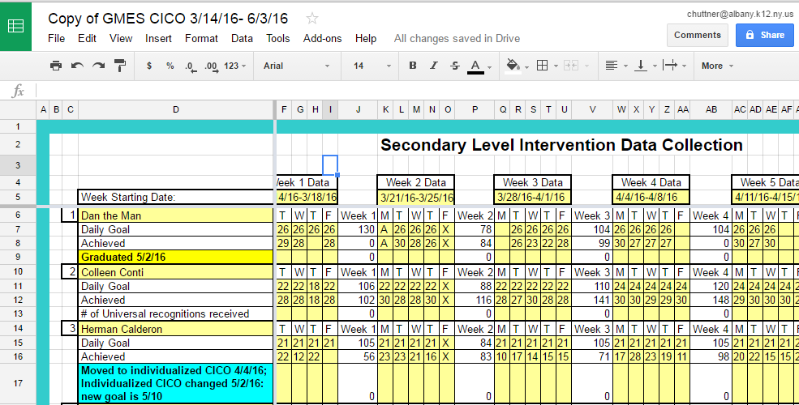
CI-CO Data Tracking

Slide 40
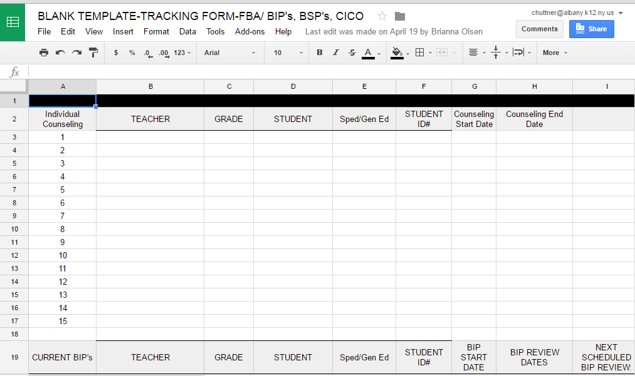
Data Tracking Sheet for All Tier 2/3 Interventions

Slide 41
Primary Tier 2 Interventions
Check in-Check Out (CI-CO)
The most widely used intervention
Most students with the exception of students who do not like attention, will benefit from this intervention
Often used prior to any other Tier 2 intervention
Most will start in a CI-CO group, but CI-CO can also be individualized
Notes:
Colleen

Slide 42
CI-CO
Most students who are being seen for CI-CO:
will have a DPR card that follows the 3 B’s and the format of the point sheet.
Individual goals should be established for the student based on their point sheet data
Individual DPR goals are established that replace the daily classroom Tier 1 goal (e.g., Instead of 24 points, 18 points is their individual goal)
Students on individualized CI-CO will probably have an individualized DPR card with one goal on it.
Once they have achieved that goal they would graduate to the 3 B’s DPR card

Slide 43
Social Academic Instructional Groups (SAIG)
SAIG’s :
Small groups that focus on a particular skill or deficit (organization, friendship, anger management, social skills…)
Should be set up as short term intervention groups that focus on a particular curriculum (6-8-10 weeks ideally)
Provided twice a week for 45 minutes (Once a week push in to classroom or a particular setting to monitor generalization)
SAIG’s are a work in progress as we look to change the current role of Psychologists and SW’s
SAIG’s should be progress monitored using the DPR card
Notes:
Colleen/Cathy

Slide 44
Behavior Support Plans BSP’S
A Behavior Support Plan (BSP):
An individualized plan
Based on anecdotal and point sheet data
Focuses on one problem behavior
Provides multiple interventions
CI-CO and SAIG’s may be a part of a Behavior Support Plan
All BSP’s need to be progress monitored using DPR’s
Notes:
Colleen

Slide 45
Tier 3
Notes:
Colleen

Slide 46
Primary Tier 3 Interventions
A Behavior Intervention Plan (BIP)
Developed following an FBA
Based on direct data collection and observations
Need WRITTEN parent permission to do FBA
Intense pre- and post-data collection/progress monitoring
Individual Counseling
Wrap-around Plan
Notes:
Cathy

Slide 47
RtI-B Sub-Committee Meetings
For students receiving Tier 2 interventions:
the RtI-B subcommittee must monitor that students intervention(s)
Is not reviewed by the full RtI committee unless moving Tiers or
significant behavioral and academic issues are occurring
The Tier 2/3 Subcommittee:
consist of the SW, Psychologist, HSC, Administrator
should meet bi-weekly or weekly alternating agendas as follows:
One week data review
One week student reviews
Looks at how all Tier 2 and 3 behavioral students are doing on a bi-weekly basis.
Notes:
Colleen/Cathy

Slide 48
What should an RtI-B Sub-Committee Meeting look like?
All students receiving Tier 2 and 3 interventions will be reviewed by this subcommittee, including:
Students on CI-CO
Students receiving SAIG
Students receiving BSPs
Students receiving SAIG
Students receiving BIPs
Students receiving any other Tier 2 interventions
Notes:
Colleen/Cathy

Slide 49
Guiding Questions for 2/3 Team reviews
Are student’s goals appropriate?
Should a goal be increased or decreased
Is this intervention appropriate for this student?
What is this student’s data telling me about this intervention?

Slide 50
Resources
District-Wide Website:
http://cityschooldistrictofalbany-rtib.weebly.com/
District resources
Tiers 1-3 District paperwork
Link to Pinterest
Links to outside resources
Elementary RtI A & RtI B Resources Quarterly Newsletter
National Center on Positive Behavior Interventions and Support
www.pbis.org
PBIS Maryland
www.pbismaryland.org

